Slide 1
Digital Methods Summer School 2017
Enedina Ortega Gutiérrez
Eloy Caloca Lafont
Monterrey Institute of Technology
Facebook as a digital ecosystem of misinformation in Mexican presidential pre-campaign 2018

Slide 2
Starting points
First exploratory study using digital methods.
Research questions:
What will be the role of Facebook pages in the upcoming Mexican presidential elections 2018?
What is the role of these pages in the actual running presidential pre-campaigns?
Are these pages official or unofficial? Pro or against? How do Facebook pages function?
Which actors take place in each case? Which new actors are observed? (trolls, for example).
How do these pages use their contents to improve or harm the image of an aspirant?
How are these pages related to information or misinformation?
Which kind of contents are presented in each page? Can these contents be automated?

Slide 3
Method
Mixed approach: quantitative and qualitative
1. Query design
-Google and google news scraping to find all the aspirants to Mexican presidential elections on july 2018 on the last month.
-Find all the possible names or nicknames per aspirant.
-Use Netvizz to extract all Facebook pages (open and active) per candidate (searching by all names and nicknames).
2. Building and cleaning a database
-Choosing the pages with larger number of fans or relevance.
3. Categorizing the Facebook pages
-Checking each page:
Type: Official vs. Unofficial
Tendency: Pro vs. Against
Function: Inform, Praise, Revile, Redirect, Clone or Troll.
4. Extraction of the posts with larger engagement per page (Netvizz)
-Wordcount analysis

Slide 4
Background
Presence of aspirants in Google News
PRI (Neoliberal, Moderate conservative)
PAN (Conservative, Christian liberalism)
PRD (Social Democratic, Moderate left)
Morena (New left)
Independent (Citizenship, public sphere)
Nueva Alianza (Syndicalism)
Undefined party (Dissidence from PRI, reformist)

Slide 5
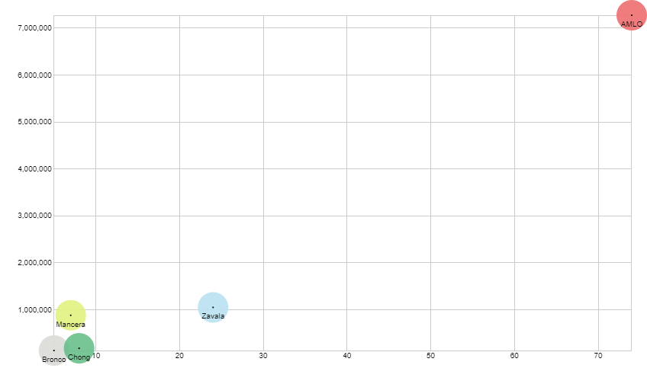
Selecting the aspirants
Facebook (open+active) pages per aspirant / Facebook pages total fans
Y= Total fans
-Andrés Manuel López Obrador
-López Obrador
-AMLO
-AMLOve
-AntiAMLO
-El Peje
-AntiPeje
-Margarita Zavala
-Margarita
-La Calderona
-La Chimoltrufia
-Miguel Ángel Osorio
Chong
-Osorio Chong
-Chong
-Miguel Ángel Mancera
-Mancera
-Jaime Rodríguez Calderón
-El Bronco
X= Number of pages (Only pages of pre campaign)

Slide 6
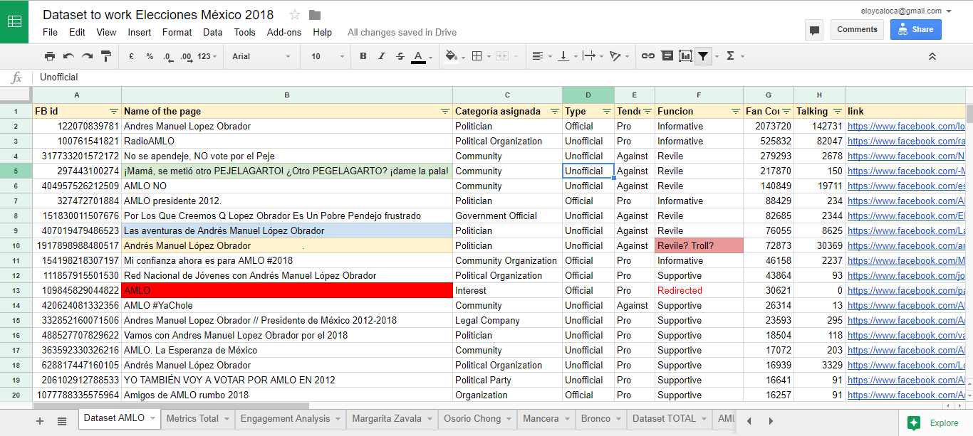
Database and categorization

Slide 7
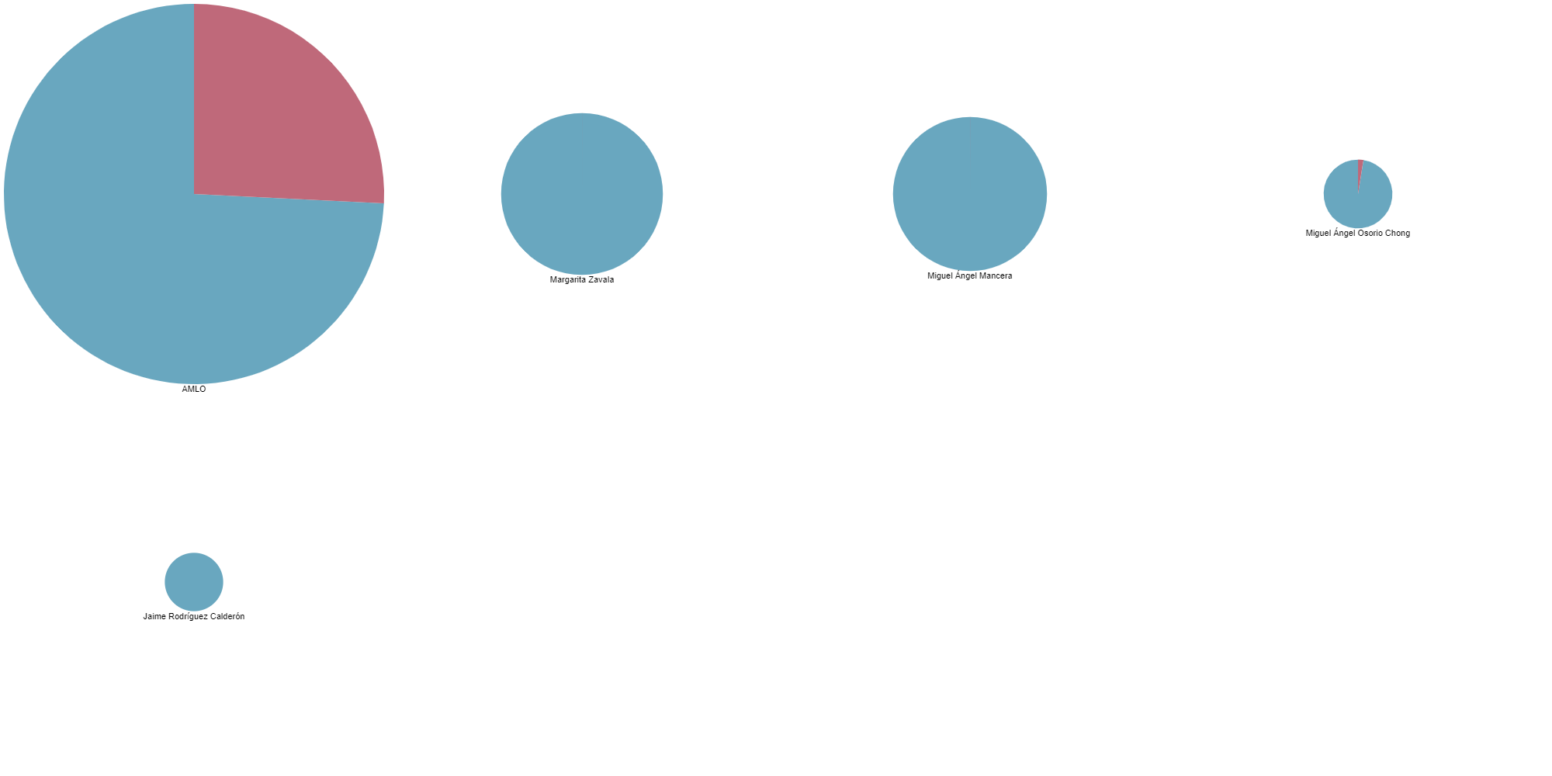
Facebook page analysis
Official or unofficial fanpage? Supporter or detractor?
Official
Unofficial
Pro
Miguel Ángel Osorio Chong
Jaime Rodríguez Calderón (“Bronco”)
Against
Margarita Zavala
Miguel Ángel Mancera
Andrés Manuel López Obrador

Slide 8
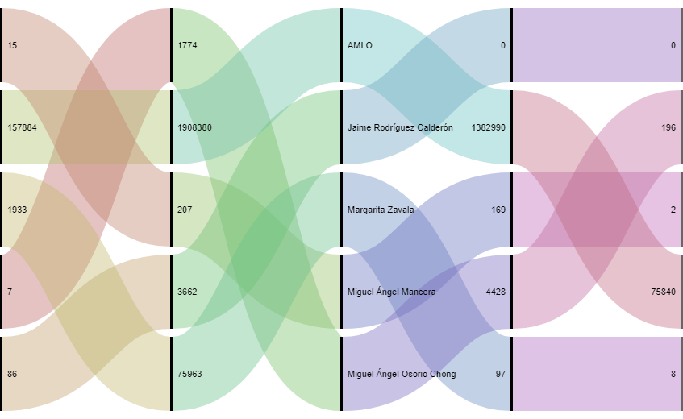
People talking about the politician fanpages
Talking about Pro pages / Fans Pro / POLITICIAN/ Fans Against / Talking about Against

Slide 9
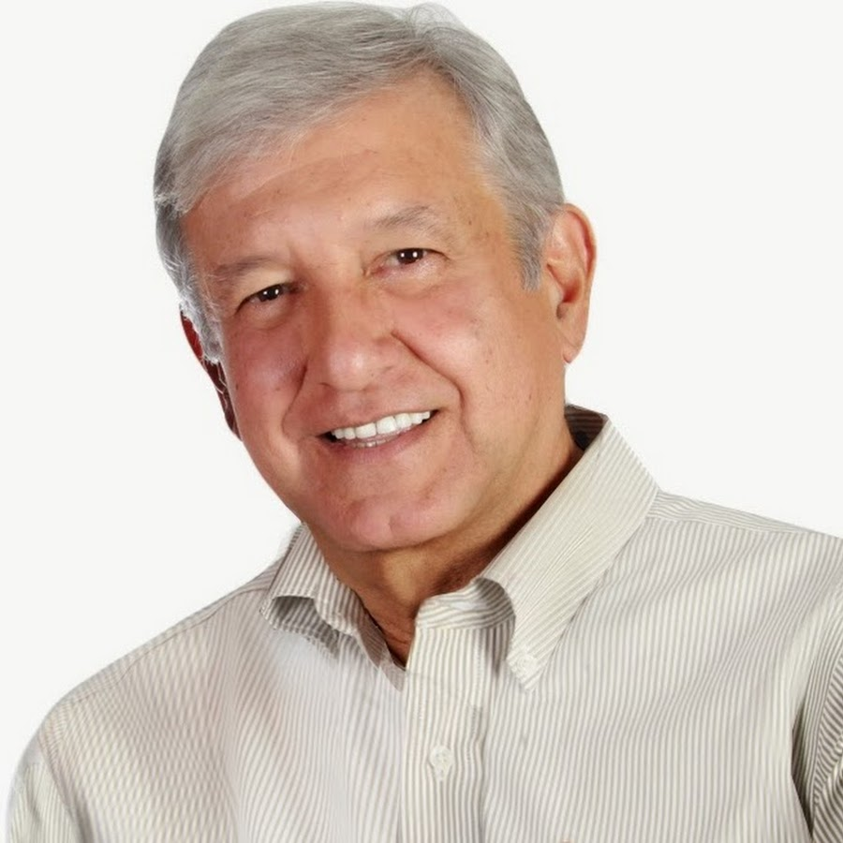
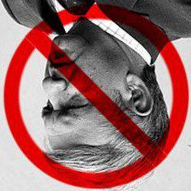
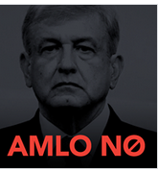
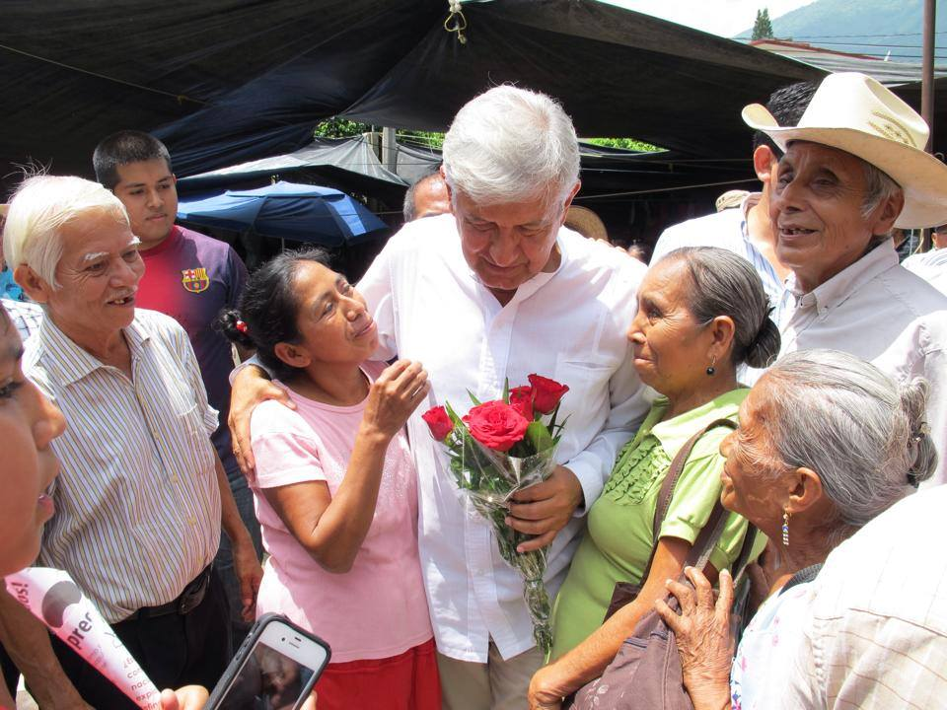
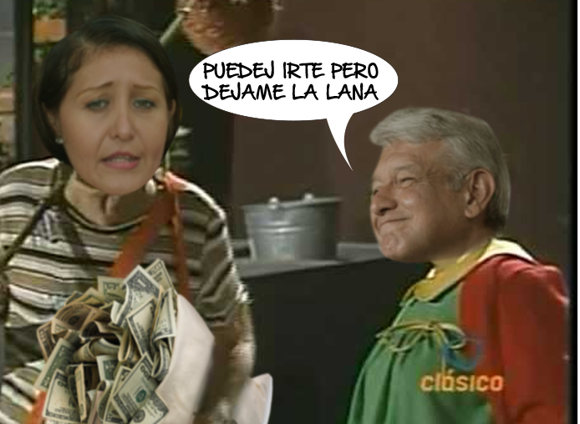
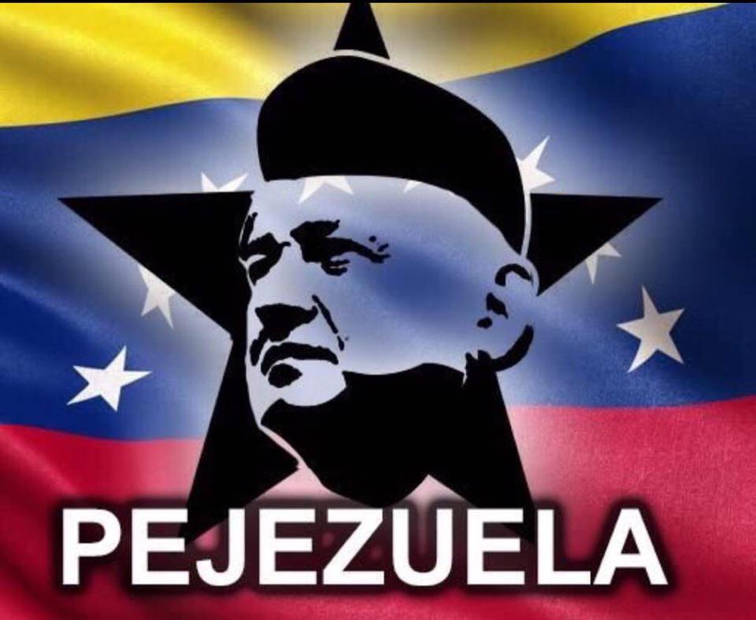
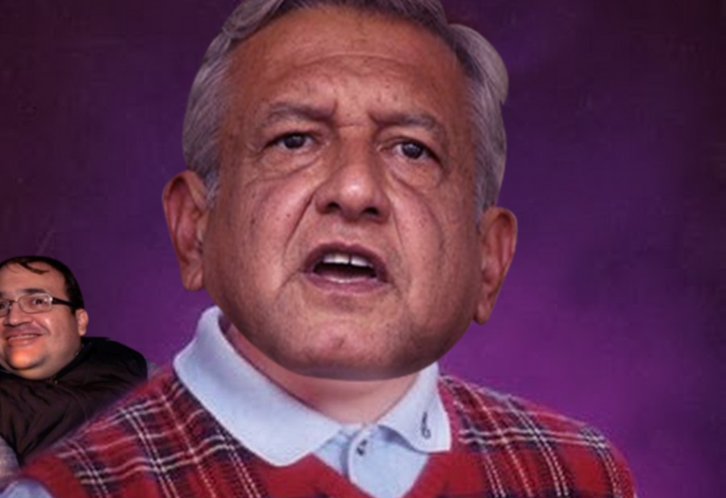
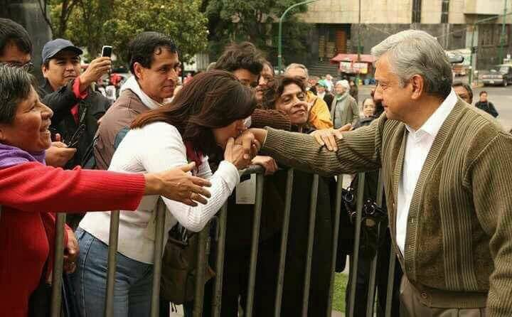
Andrés Manuel López Obrador
Supporter and revile posts

Slide 10
Andrés Manuel López Obrador
Supporter posts Most engaged wordcount analysis

Slide 11
Andrés Manuel López Obrador
Revile posts Most engaged wordcount analysis

Slide 12
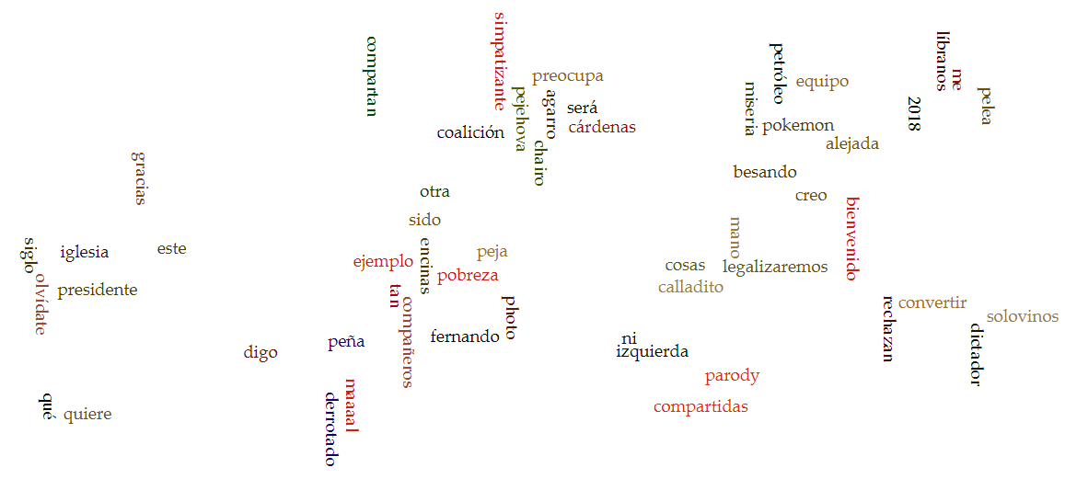
Andrés Manuel López Obrador
Revile posts Most engaged wordcount analysis

Slide 13
Some Findings
Even it is forbidden to start a presidential campaign in Mexico before 2018, there are 25 actual aspirants that have shown they will run for president in news and webpages.
Facebook presidential war have started: There are around 2000 active pre-campaign pages and they have around 2 million fans in total. These may be related to the lack of regulations in Mexico on social media and the huge difficulties to regulate them.
Andrés Manuel López Obrador is the most polemical figure in Mexico.
The Facebook ecosystem is used by each (pre)candidate, but also by unofficial supporters and detractors that can be either public figures (journalists, analysts) or anonymous citizens (based on the authors of the posts). There are also troll pages with absurd content to ridicule or make fun of a politician using indecent and sexist language.
We will keep working on a typology of Facebook fanpages in a campaign.

