Slide 1
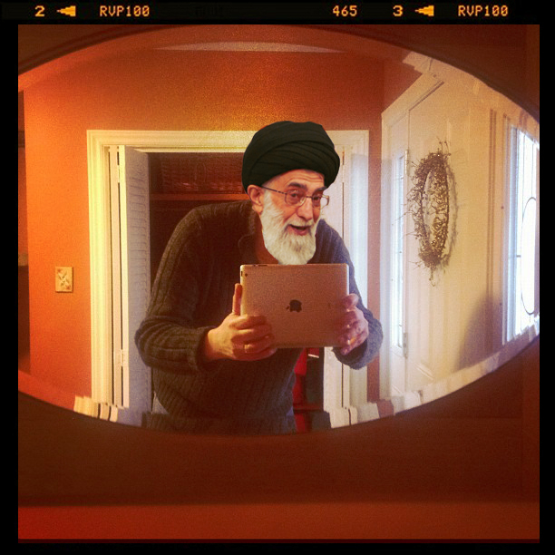
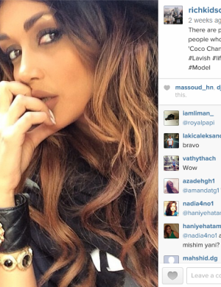
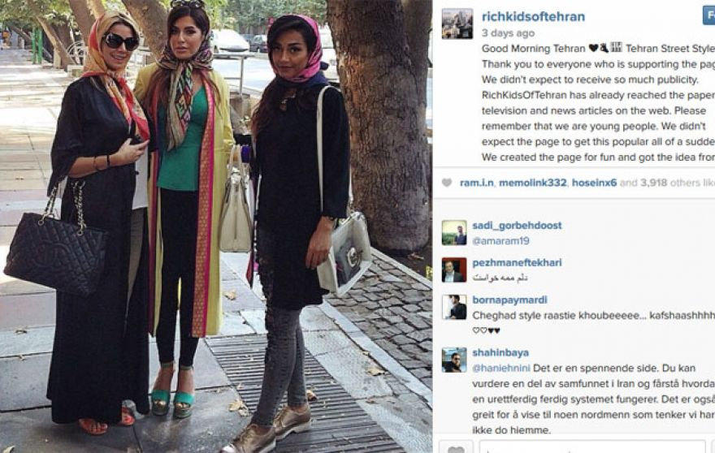
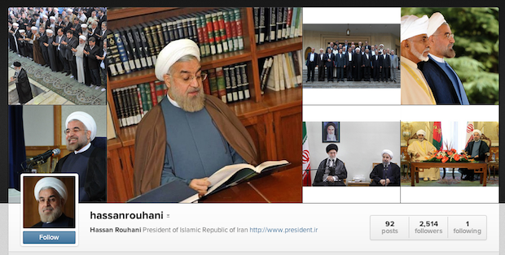
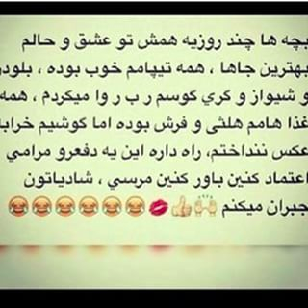
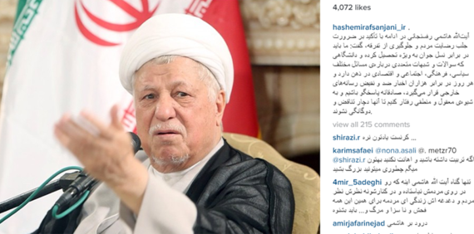
Iranian Censorship and Information Ecologies
Controlling the flow of information on social media in Iran

Slide 2
How is the Iranian government censoring and shaping the flow of information on Instagram?
Part A
How to characterize the sophistication of Iranian censorship efforts. Is the Iranian government targeting images to censor or is Instagram crossing with censored IP ranges for Facebook?
Part B
What does the network ecology of Iranian activists, government opposition, and pro-regime Instagram accounts look like?
Are there significant characteristics in these networks that help us identify suspicious accounts and/or if the government is manipulating the followers

Slide 3
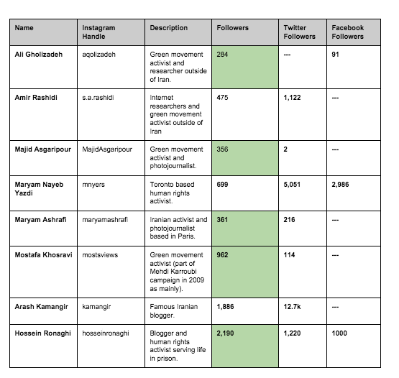
Why Instagram?

Slide 4
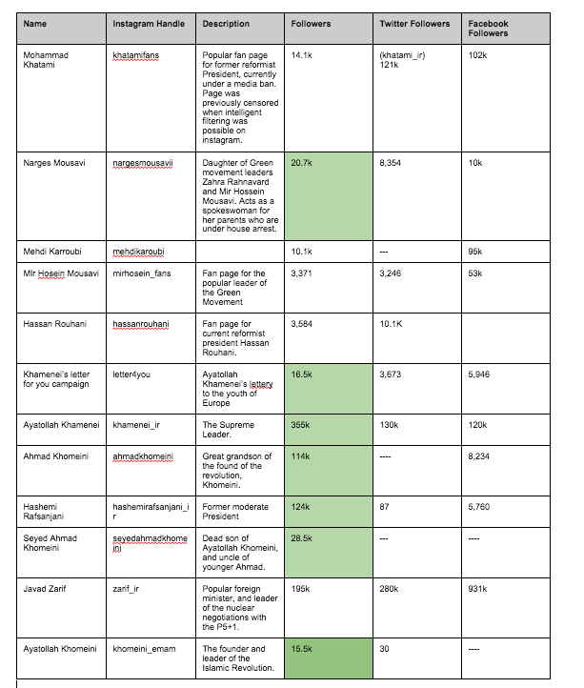

Slide 5
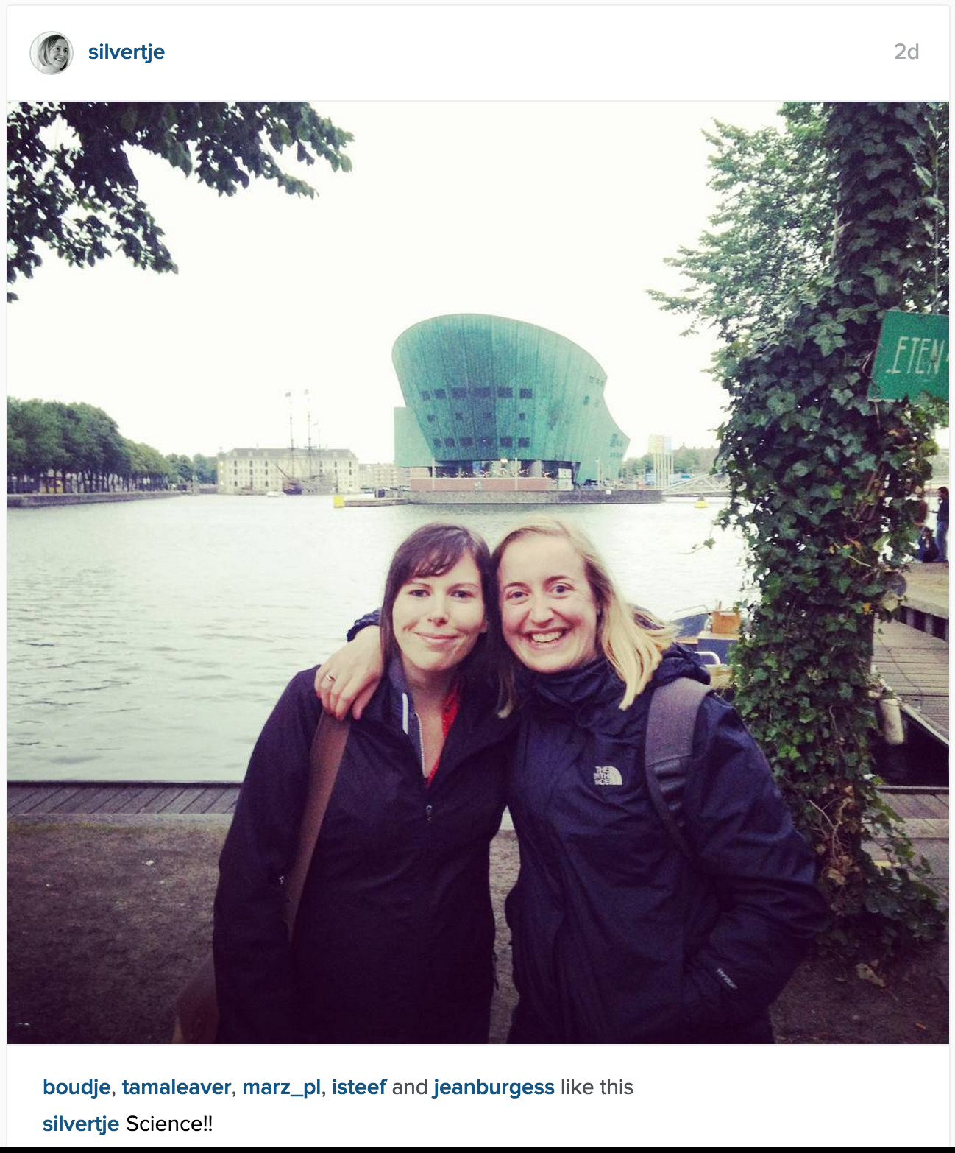
Notes:
instagram not blocked in Iran, while FB is

Slide 6
Notes:
but there are reports that sometimes seemingly innocuous instagram images are not accessible for some periods of time
what’s going on?
Good to realize same image hosted on different servers.
While URL of image will stay the same, CDN will decide to serve you an image from a specific server in a location that will provide you results the quickest.
So we tested whether particular CDN locations were blocked.

Slide 7
Method - Test blockage of FB CDNs
Gather all IP address assigned to Facebook (Instagram)
/usr/bin/whois -h whois.radb.net '!gAS32934' | tr ' ' '\n' | sort -n -k1,1 -k2,2 -k3,3 -k4,4
Gather host names (for a subrange of all FB CDN IPs)
179.60.192.6 6.192.60.179.in-addr.arpa domain name pointer edge-z-1-shv-01-cdg2.facebook.com.
179.60.192.7 7.192.60.179.in-addr.arpa domain name pointer xx-fbcdn-shv-01-cdg2.fbcdn.net.
179.60.192.8 8.192.60.179.in-addr.arpa domain name pointer z-m-fbcdn-shv-01-cdg2.fbcdn.net.
179.60.192.9 9.192.60.179.in-addr.arpa domain name pointer instagram-shv-01-cdg2.fbcdn.net.
Test whether the hosts are accessible on port 80 (HTTP) and 443 (HTTPS) in both IR and NL
telnet instagram-shv-01-cdg2.fbcdn.net 80
telnet instagram-shv-01-cdg2.fbcdn.net 443
Compare results
Notes:
For a total list of 23712 IP addresses, 5431 hostnames were found, 100 of which mentioned instagram.

Slide 8
Findings - Censorship
Results are same for domain and IP (no overblocking?)
Comparing IR and NL
64% of HTTPS connections fail in IR, but not in NL
6% of HTTP connections fail in IR, but not in NL
Thus:
images served over HTTPS are (generally) being blocked in Iran
no content based blocks but (temporary) inaccessibility based on the IP addresses used by the CDN
Speculation: sporadic inaccessibility of Instagram images is collateral damage from Facebook block (accidental overblocking?)

Slide 9
Methodology - Instagram Networks
Build seed samples of Instagram accounts (activists, government opposition, and pro-regime accounts, based on previous research)
Enter lists of accounts into the DMI Instagram Network Collection Tool (https://tools.digitalmethods.net/beta/instagramNetwork/) to gather follower networks
Open the network graphs and analyse trends in Gephi
Take the usersnames of follower networks from the tool’s CSV output and enter these in the DMI Instagram User Info Scraper: https://tools.digitalmethods.net/beta/instagramUserInfo/
Examine and compare user info from different follower networks.

Slide 10
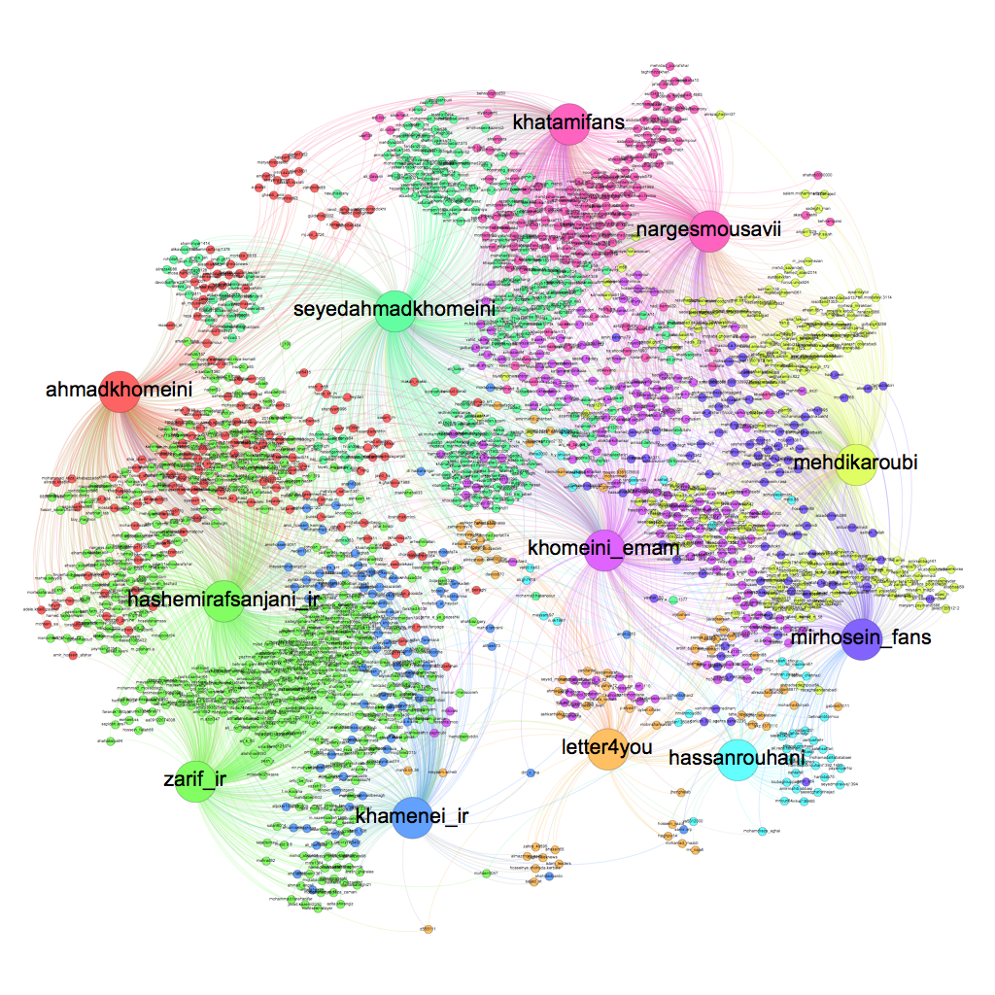

Slide 11
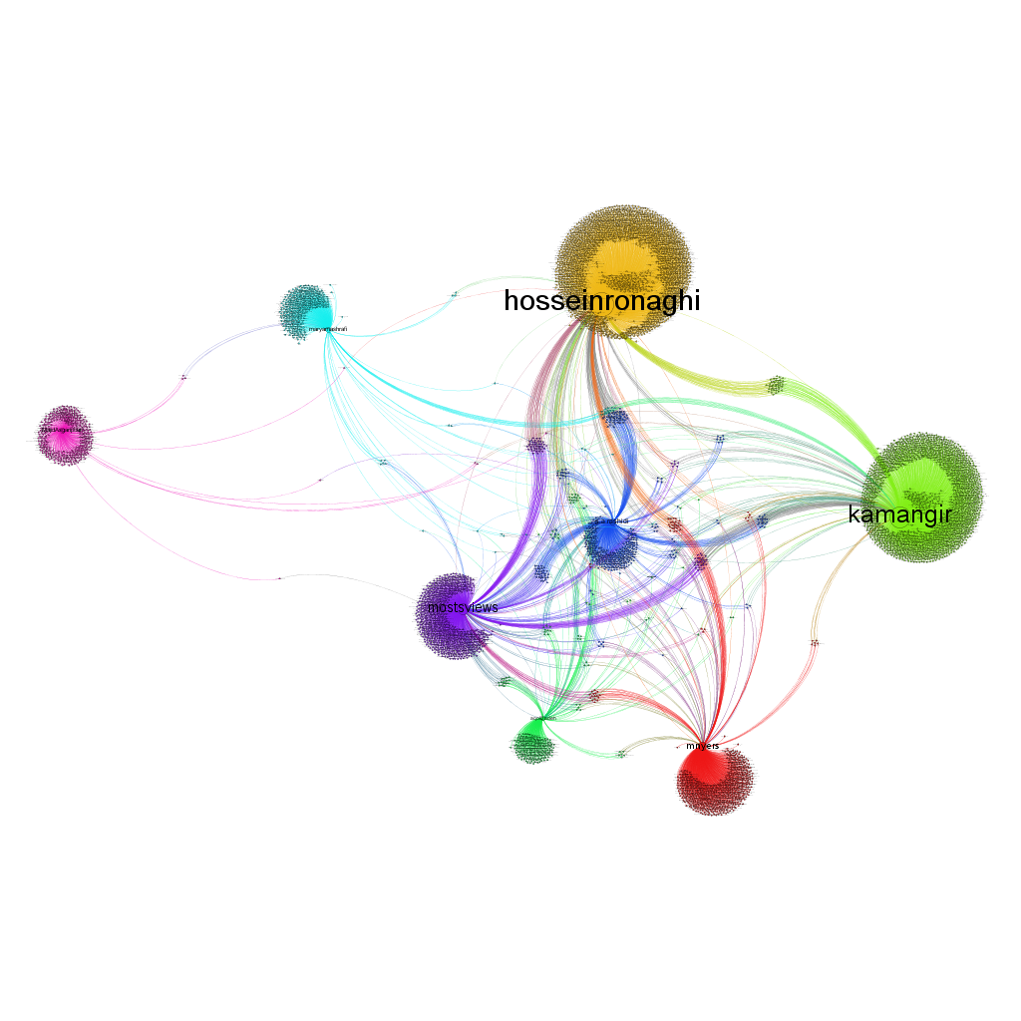

Slide 12
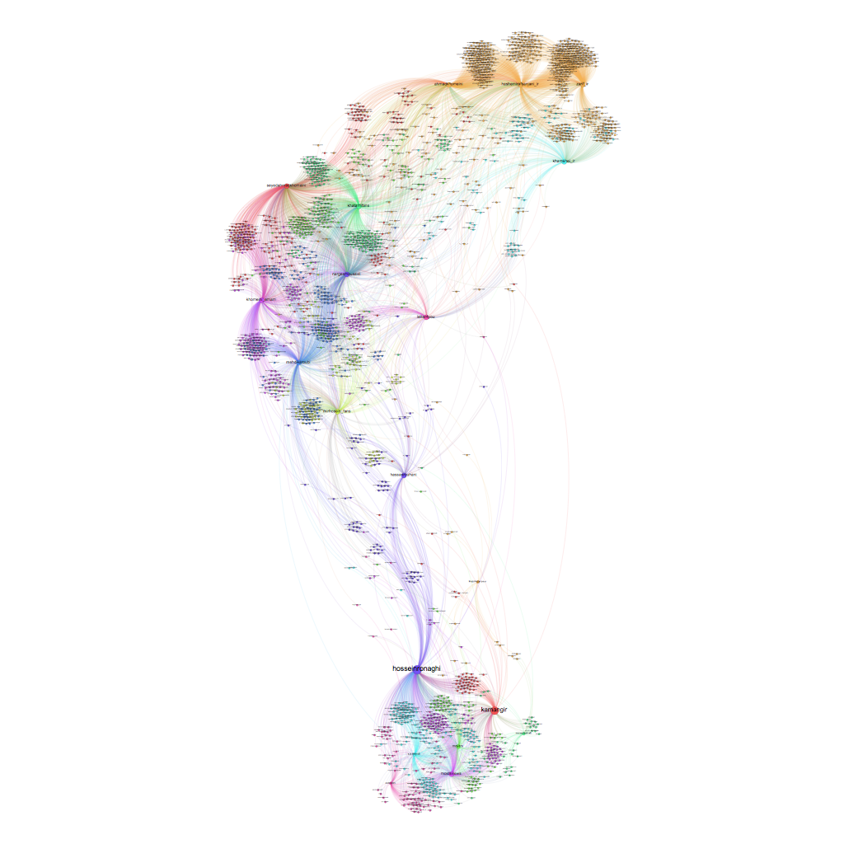

Slide 13
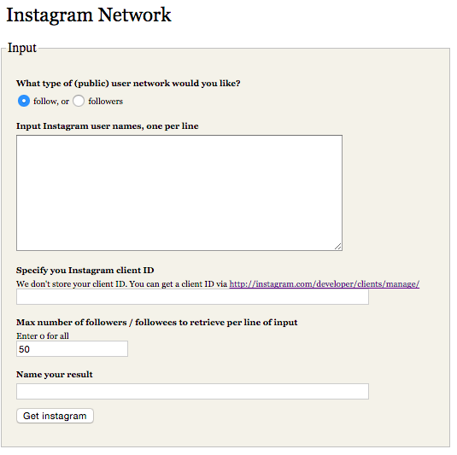
Findings - Instagram User Info
7,184 activist accounts (4,290 public)
7,997 pro-regime followers (5,230 public)
0 POSTS:
9% of activist public accounts
26% of pro-regime public accounts

Slide 14
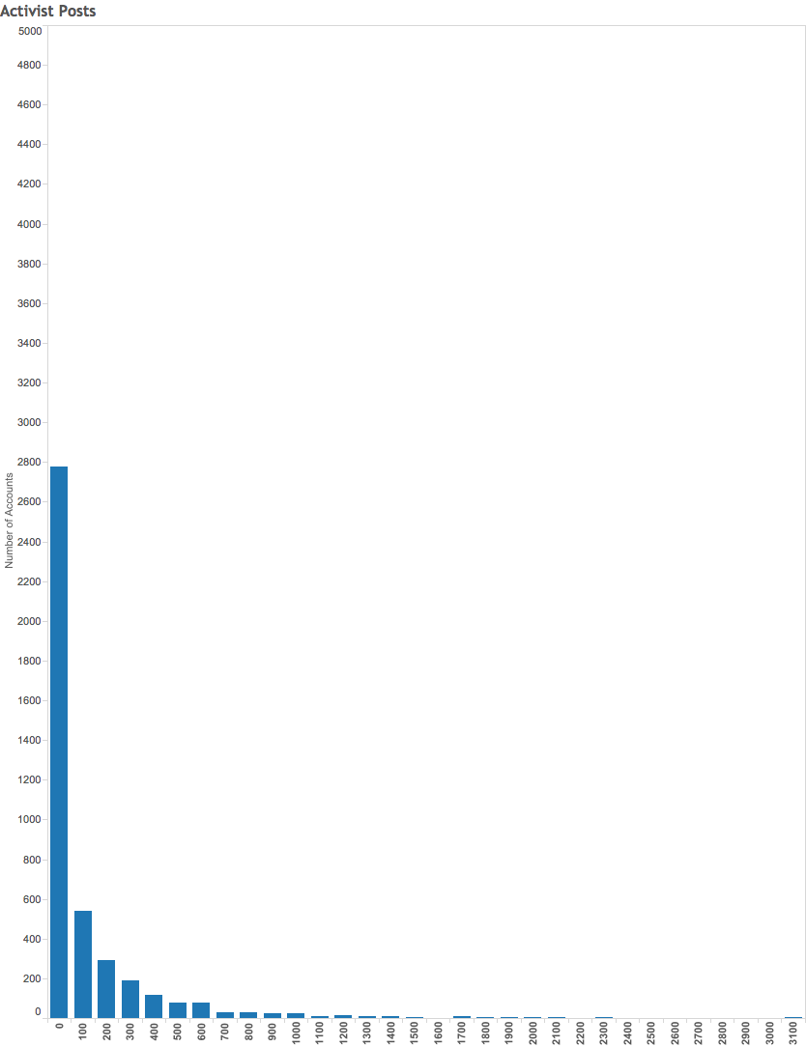
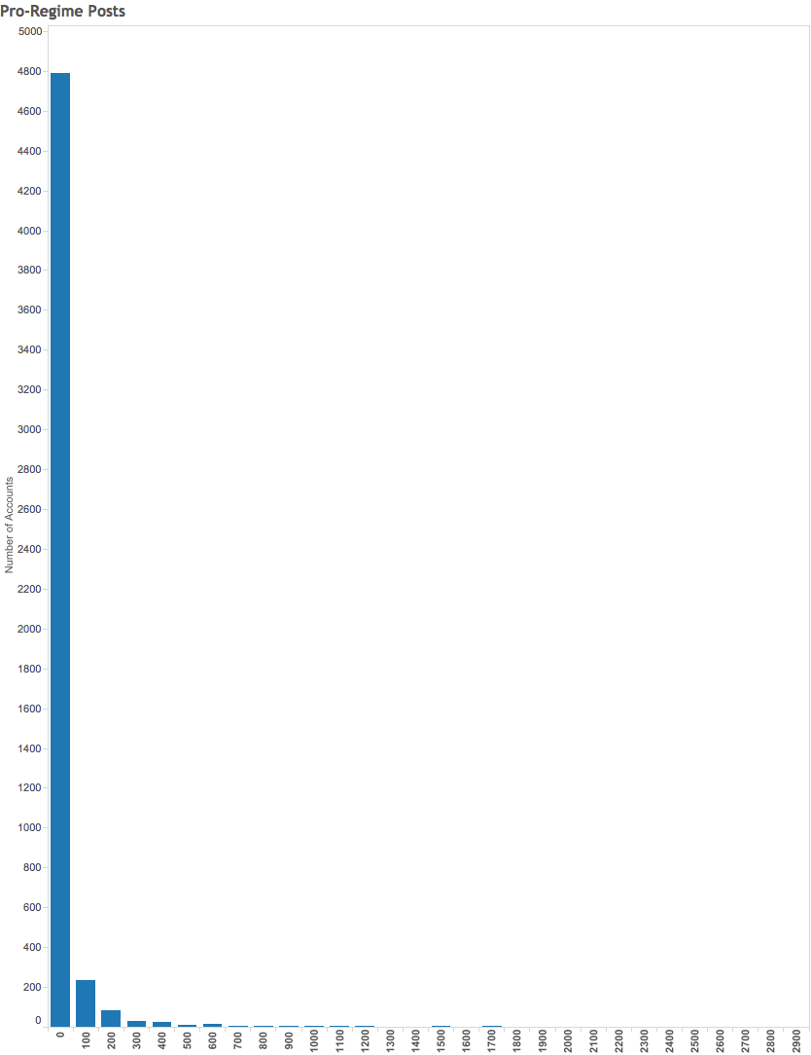

Slide 15
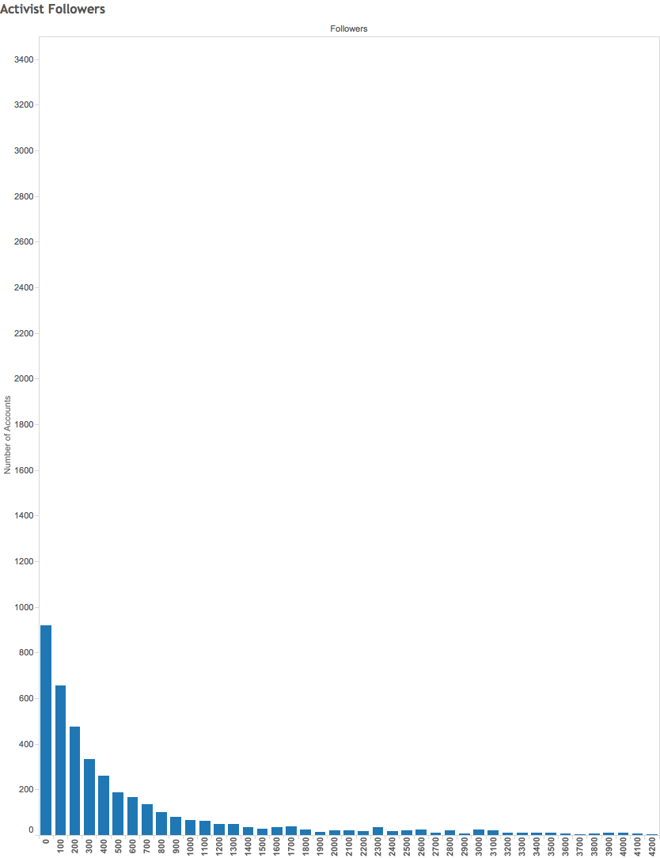
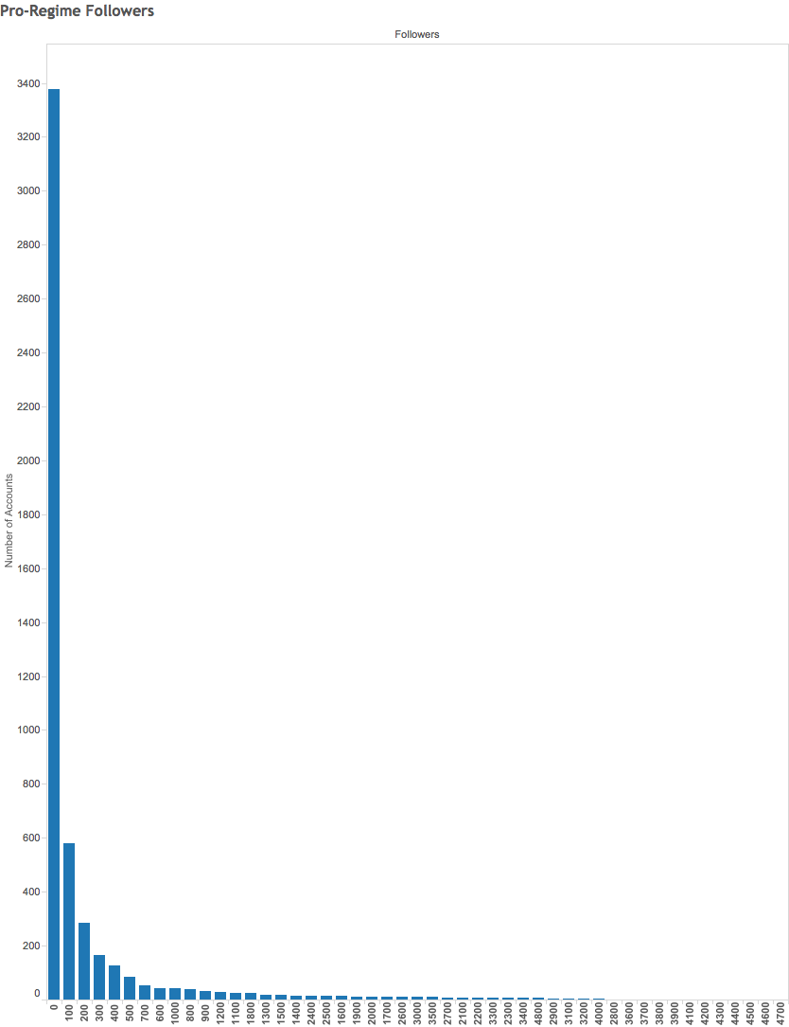

Slide 16
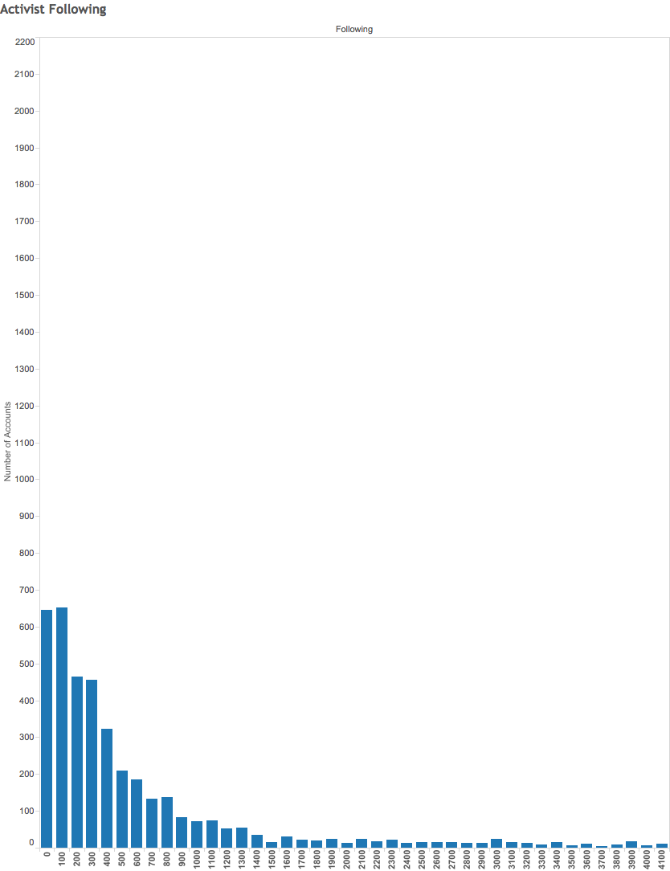
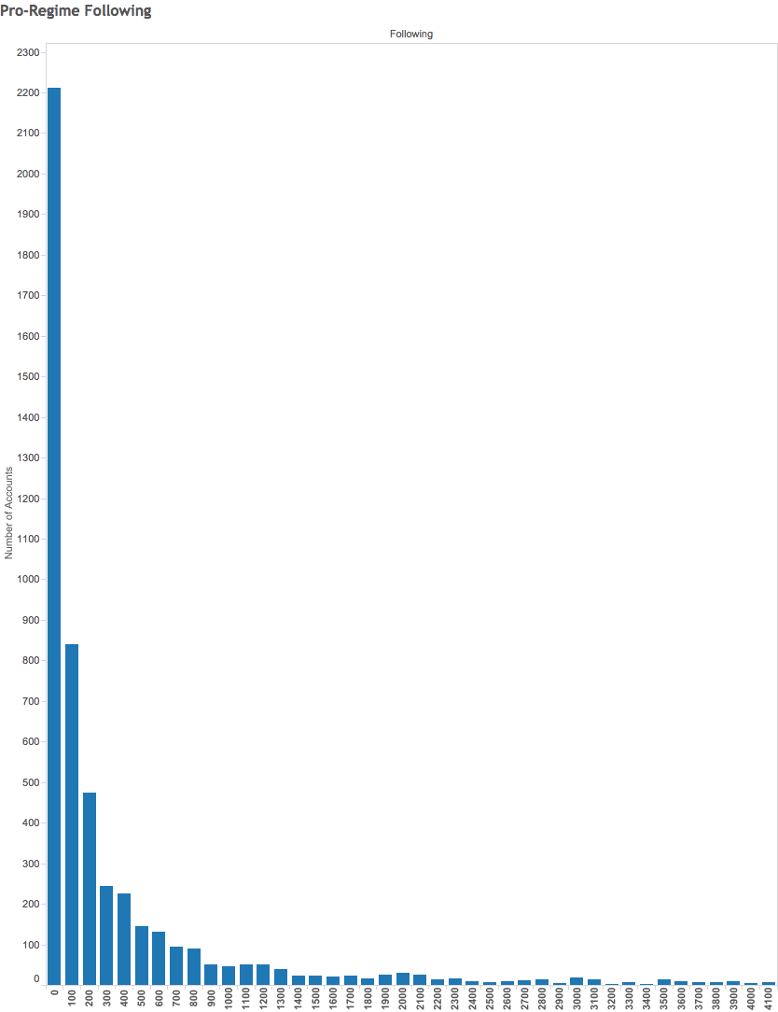

Slide 17
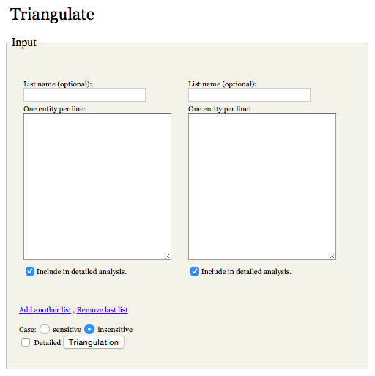
Network comparison
Compared networks through the DMI Triangulation tool
1,106 users in both networks, high likelihood of suspicious accounts
Similar indications for fake accounts on Twitter - e.g. “This score is based on number of tweets, date of the last tweet, and ratio of followers to friends” from TwitterAudit

Slide 18
Conclusion
Iranian censorship is not THAT sophisticated. It’s likely collateral damage from the Facebook block
Instagram is increasingly reshaping social media use in Iran. Influential Iranians have more followings on Instagram than on Twitter or Facebook. Followers are shared by disparate groups.
There were clear differences between users in the activist follower network and the pro-regime follower network, with pro-regime accounts being much less active on Instagram (and therefore kind of suspicious).

